Slide 1

Cervical Cancer Risk Factors
Kristie Kooken

Slide 2
Today’s presentation
Overview of cervical cancer
Project Goals: Groundbreaking invention
Model development
Project results
Next steps

Slide 3
Cervical Cancer
United States → Annually: 11,500 diagnoses & 4,000 deaths
Globally → 2020: 604,000 diagnoses & 342,000 deaths
Human papillomavirus (HPV) is thought to be responsible for 90% of all cervical cancers
HPV is contracted by having sex with a person who has the virus
Two characteristics of this cancer
Women > 30 years old
Long lasting infection with certain types of HPV

Slide 4
Cervical Cancer
93% of all cases of cervical cancer are preventable
With screening tests and HPV vaccination

Slide 5


Project Goals
Develop an invention that uses machine learning
Cost effective app-based tool
Predicting cervical cancer and HPV based on health info & risk factors
Gives pathway for next steps for medical care or intervention
Ensures privacy
Health & Screening info

Slide 6
Model Development: Data Source
University of California, Irvine under the name Cervical cancer (Risk Factors) Data Set
Collected at Hospital Universitario de Caracas in Caracas, Venezuela
858 subjects and 36 variables

Slide 7
Model Development: Variables
Binary categories:
Cancer diagnosis, HPV diagnosis
STD Y/N questions
Smoking Y/N
Birth Control Y/N
Continuous:
Age
Length of STDs
Length of Smoking
Length of Birth Control

Slide 8
Model Development: Understanding the data
All females
Average age 26.8 years
Cervical cancer diagnoses make up 2% of the data
18 cases
HPV diagnoses make up 2% of the data
18 cases
16 out of 18 cervical cancer & HPV diagnoses are for the same patients

Slide 9
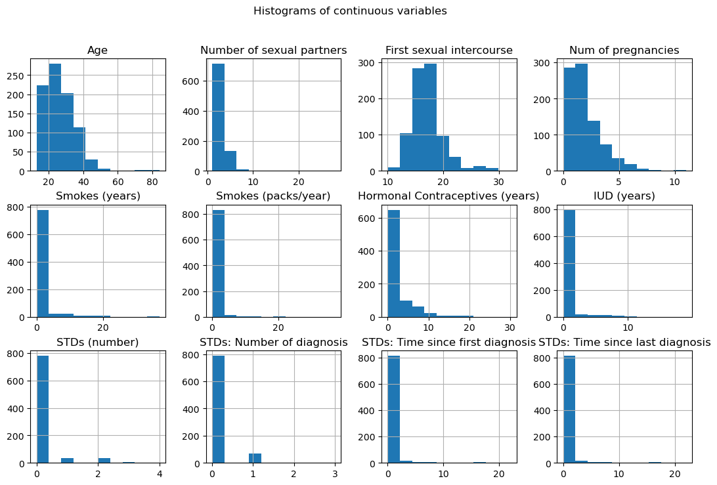
Model Development: Data cleaning
Replace missing values
Keep all records due to rare outcome
Check distributions before and after missing value imputation

Slide 10
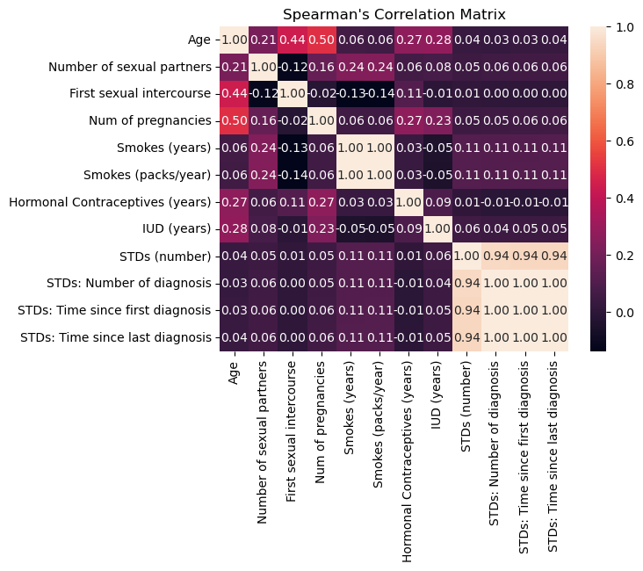
Model Development: Dropping variables
Using correlation to determine relationship between continuous variables
4 variables are dropped
+2 variables with no documentation

Slide 11
Model development: Methodology
Logistic regression: Standardized input
2 models, Cervical Cancer, HPV
Feature Selection
Keeping only relevant features
Addressing imbalance
Diagnoses of cervical cancer or HPV is rarer
Final model on balanced data
Performance metrics

Slide 12
Results: Logistic Regression final model
Model | Accuracy | Class | Precision | Recall | F1 | Support
Baseline Logistic Regression | 0.98 | 0 | 0.98 | 1.00 | 0.99 | 210
 | - | 1 | 0.00 | 0.00 | 0.00 | 5
Final Logistic Regression | 0.87 | 0 | 0.98 | 0.88 | 0.93 | 210
 |  | 1 | 0.07 | 0.40 | 0.12 | 5

Slide 13
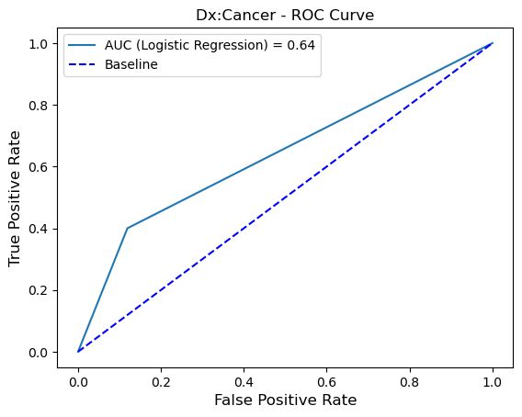
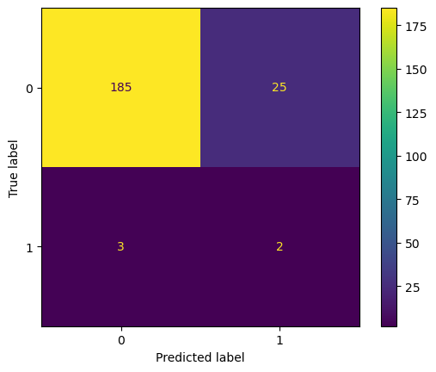
Model Results: More accurate but shows room for improvement

Slide 14
Conclusions
The ability to accurately predict a cervical cancer or HPV diagnosis would be a great advantage for all humanity.
Privacy concerns will remain a concern.
Information gained from this effort does demonstrate a need for further modeling
Ask:
More funding
Subject matter expert
More time

Slide 15
Questions ?

Slide 16
References
HPV Vaccination: What Everyone Should Know (Accessed 2023, August 11). Vaccines and Preventable Diseases. https://www.cdc.gov/vaccines/vpd/hpv/public/index.html
What Should I Know About Screening? (Accessed 2023, August 11). Gynecologic Cancers. https://www.cdc.gov/cancer/cervical/basic_info/screening.htm
HPV-Associated Cancer Statistics (Accessed 2023, August 11). HPV and Cancer. https://www.cdc.gov/cancer/hpv/statistics/index.htm

